Slide 1
Team “Porto Flip”
Game: Ninja flipper
GitHub: https://github.com/DimitarSD/Teamwork-Porto-Flip
Link: https://cdn.rawgit.com/DimitarSD/Teamwork-Porto-Flip/master/Game/index.html

Slide 2
Team members
Aleksander Angelov – Obelixx
Biser Sirakov – BiSirakov
Gergana Belcheva – gbelcheva
Dimitar Dzhurenov – dsd321
Ivelina Popova – iwelina.popova
Iliana Bobeva – IlianaB
Tatyana Rangelova – TanyaRan

Slide 3
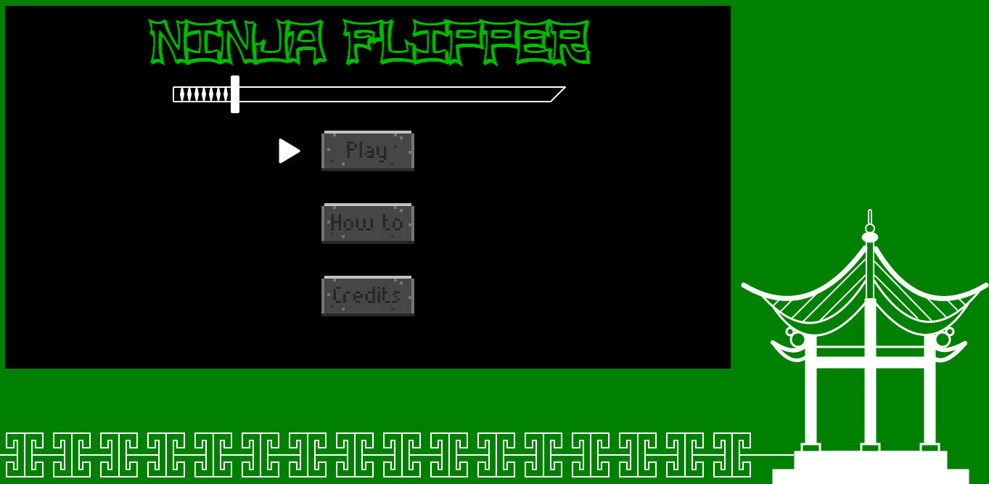
The game

Slide 4
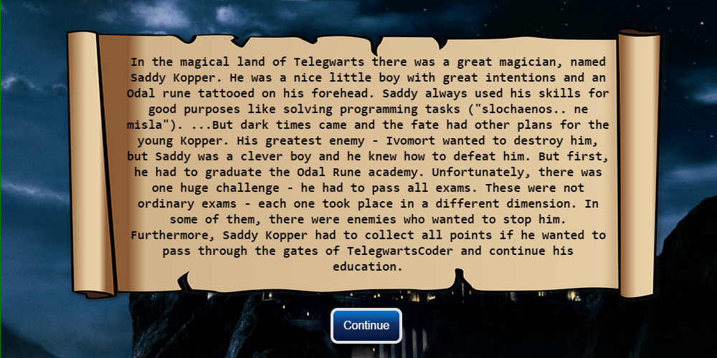
The idea

Slide 5
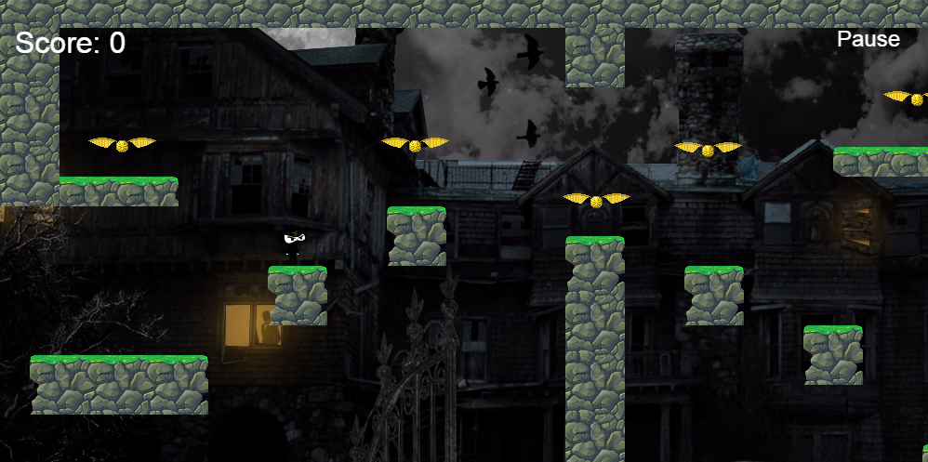
4 Levels

Slide 6
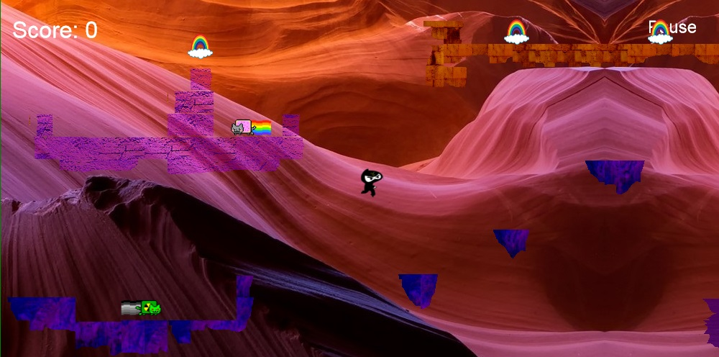

Slide 7
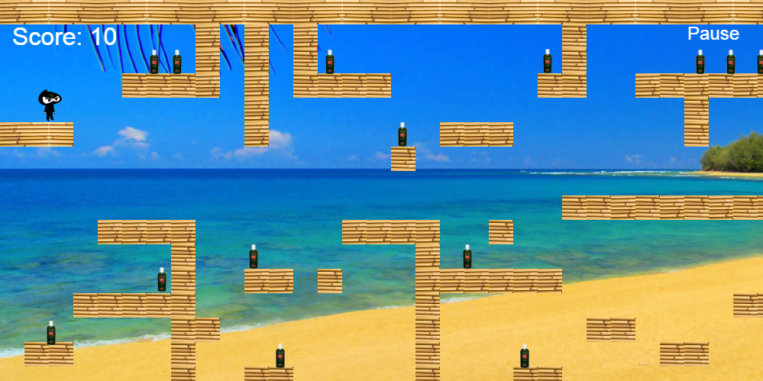

Slide 8
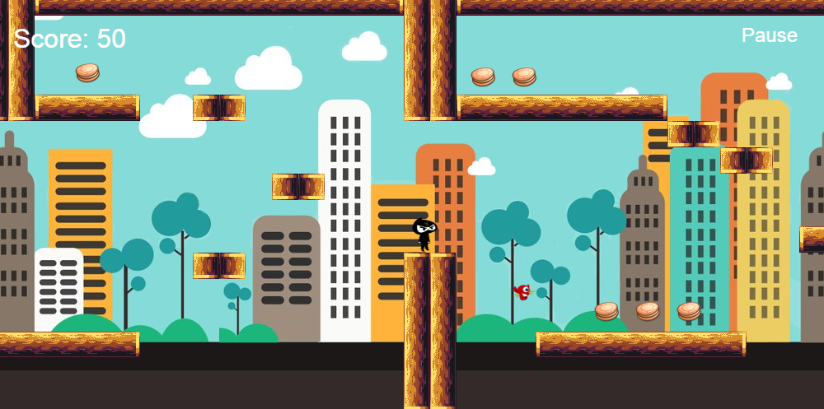

Slide 9
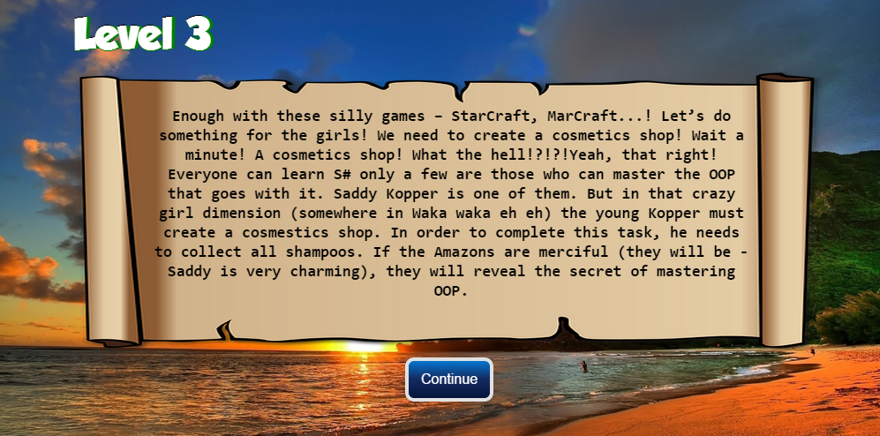
Prehistory for each level

